Slide 1
SET OPERATORS

Slide 2
DEFINITION
Relational set operators are used to combine or subtract the records from two tables.
Used in the SELECT query to combine the records or remove the records.
Union Compatibility: Same number of columns must participate in the query and the datatypes of respective columns should be same. The resulting records will also have same number of columns and same datatypes for the respective column.

Slide 3
UNION
combines the similar columns from two tables into one resultant table.
Avoid duplicates in result.
The resulting records will be from both table and distinct.
Syntax:
SELECT expression1, expression2, ... expression_n
FROM tables
[WHERE conditions]
UNION
SELECT expression1, expression2, ... expression_n
FROM tables
[WHERE conditions];

Slide 4
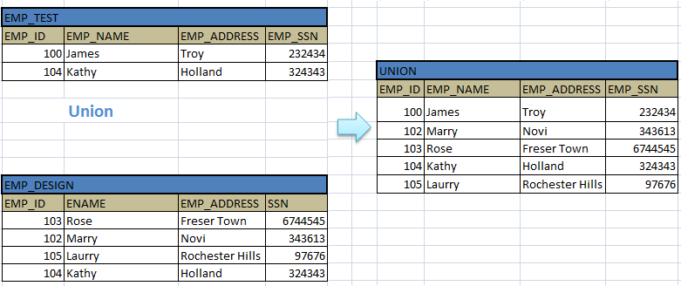
SELECT EMP_ID, EMP_NAME, EMP_ADDRESS, EMP_SSN FROM EMP_TEST UNION SELECT EMP_ID, EMP_NAME, EMP_ADDRESS, EMP_SSN FROM EMP_DESIGN;

Slide 5
UNION ALL
Similar to union, but include duplicates.
Syntax:
SELECT expression1, expression2, ... expression_n
FROM tables
[WHERE conditions]
UNION ALL
SELECT expression1, expression2, ... expression_n
FROM tables
[WHERE conditions];

Slide 6
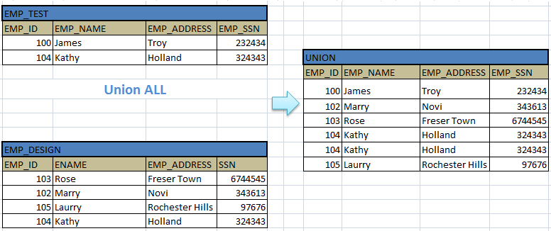
SELECT EMP_ID, EMP_NAME, EMP_ADDRESS, EMP_SSN FROM EMP_TEST UNION ALL SELECT EMP_ID, EMP_NAME, EMP_ADDRESS, EMP_SSN FROM EMP_DESIGN;

Slide 7
INTERSECT
This operator is used to pick the records from both the tables which are common to them.
Avoid duplicates.
Syntax:
SELECT expression1, expression2, ... expression_n
FROM tables
[WHERE conditions]
INTERSECT
SELECT expression1, expression2, ... expression_n
FROM tables
[WHERE conditions];

Slide 8
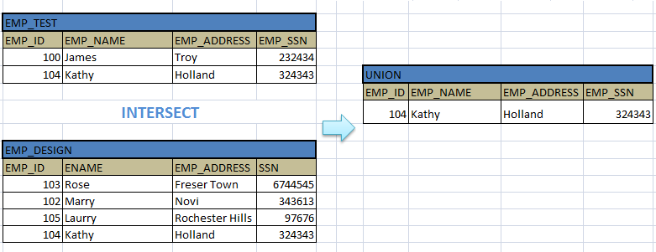
SELECT EMP_ID, EMP_NAME, EMP_ADDRESS, EMP_SSN FROM EMP_TEST INTERSECT SELECT EMP_ID, EMP_NAME, EMP_ADDRESS, EMP_SSN FROM EMP_DESIGN;

Slide 9
MINUS
This operator is used to display the records that are present only in the first table or query, and doesn’t present in second table / query.
Syntax:
SELECT expression1, expression2, ... expression_n
FROM tables
[WHERE conditions]
MINUS
SELECT expression1, expression2, ... expression_n
FROM tables
[WHERE conditions];

Slide 10
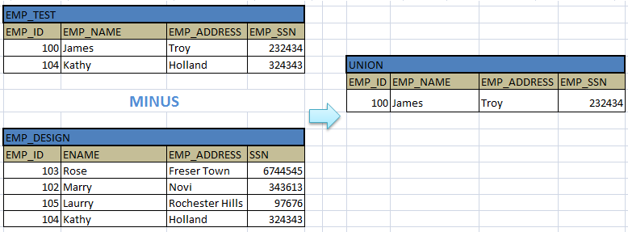
SELECT EMP_ID, EMP_NAME, EMP_ADDRESS, EMP_SSN FROM EMP_TEST MINUS SELECT EMP_ID, EMP_NAME, EMP_ADDRESS, EMP_SSN FROM EMP_DESIGN;

Slide 11
JOINTS – FULL JOIN
This join combines the results of both left and right outer joins.
The joined table will contain all records from both the tables and fill in NULLs for missing matches on either side.
Syntax:
SELECT column-names
FROM table-name1 FULL JOIN table-name2
ON column-name1 = column-name2
WHERE condition;

Slide 12
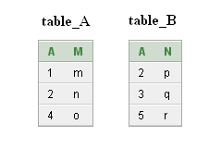
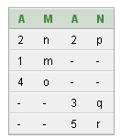
SELECT * FROM table_A FULL OUTER JOIN table_B ON table_A.A=table_B.A;

Slide 13
THANK YOU

